Slide 1
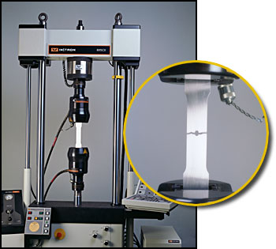

In-Process Metrics for Software Testing
Left – In materials testing, the goal always is to break it! That’s how you know how strong it is.
Kan Ch 10
Steve Chenoweth, RHIT
Notes:
Image from http://coldwork.com/services/material-testing.

Slide 2

Of course, that method has limits!
Notes:
Calvin & Hobbes cartoon from http://www.aplaceofsense.com/2010/02/engineering-humor-calvins-bridge-test.html.

Slide 3
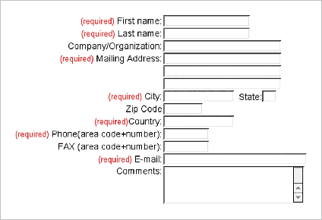
Lots of testing metrics get proposed
Question is – how much experience backs them up?
For each, also need to know:
  Purpose
  Data required
  Interpretation
  Use
Right – It’s like the “Required” data on a form.
Notes:
Image from http://guidelines.usability.gov/guidelines/126.

Slide 4
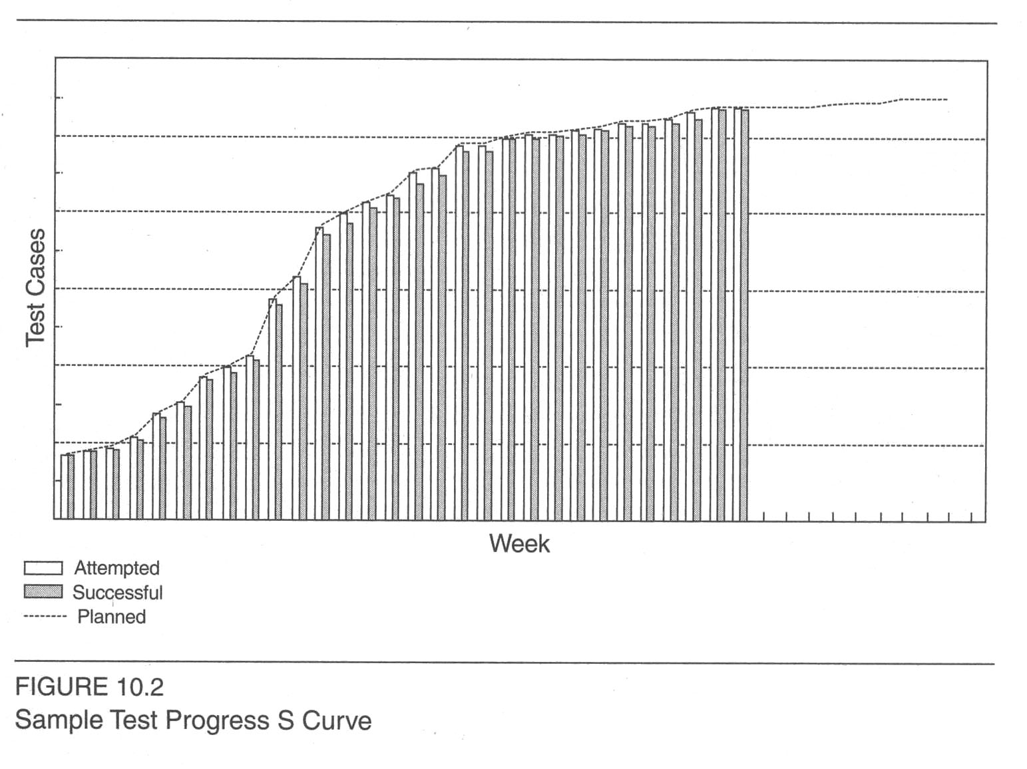
The test progress S curve
Looks suspiciously close to plan, huh!
Notes:
Kan p 275

Slide 5
Of course…
Some test cases are more important than others.
  Could assign scores to test cases.
  Like 10 = most important, 1 = least.
  Always subjective.
Test points should be planned.
  What’s possible to test, when.

Slide 6
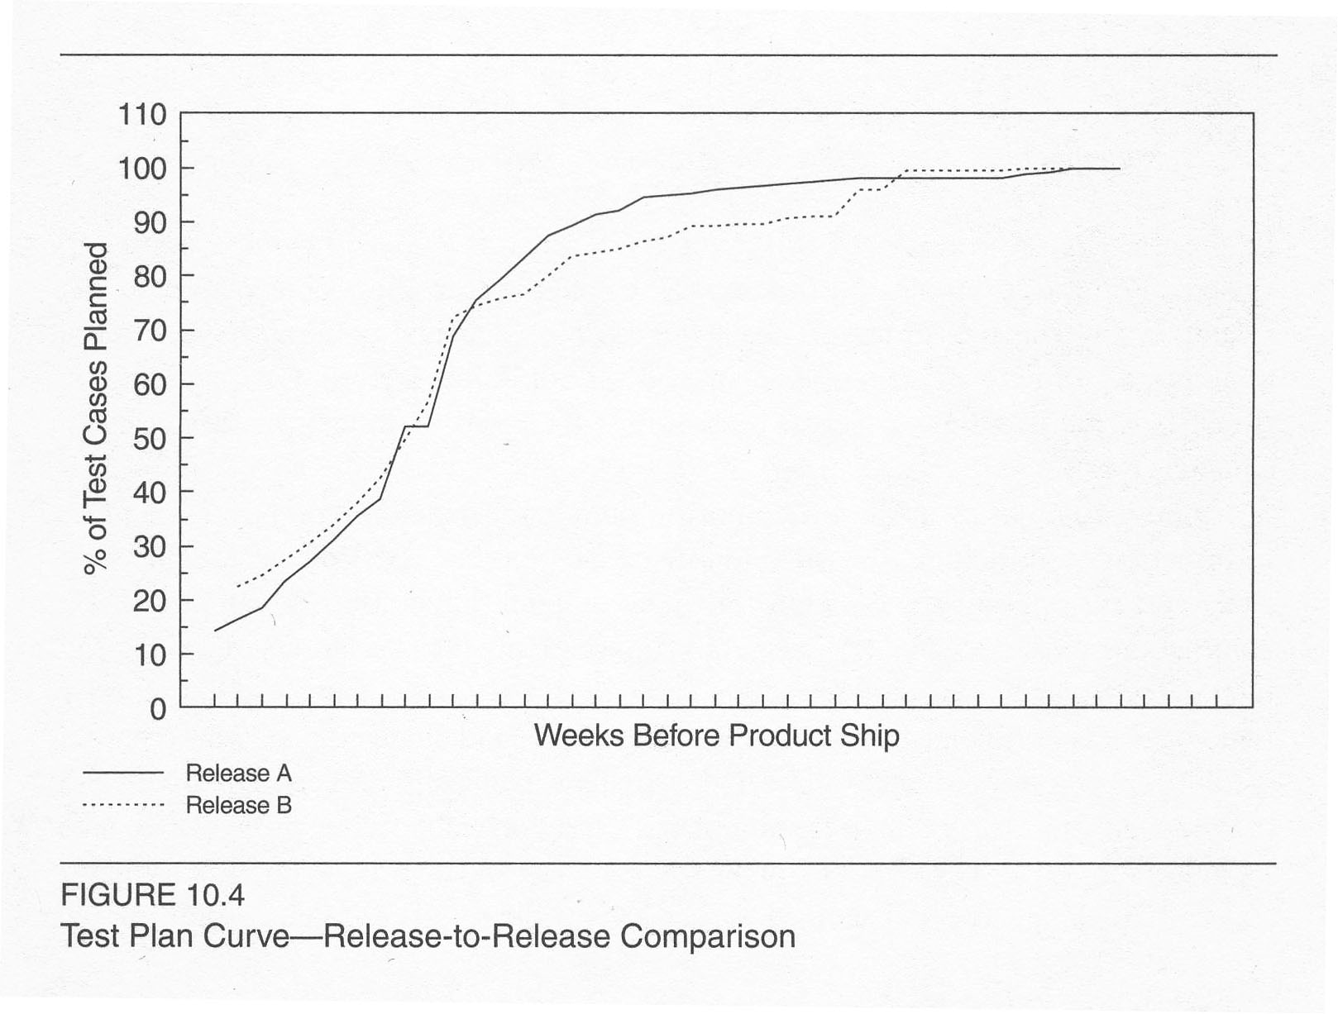
Can then compare products
Notes:
Kan p 279

Slide 7
Tracking defect arrivals
Testing progress – usually built into tools.
Defect arrival pattern over time is important.
Defect density during testing – a summary indicator, but
  Not an in-process indicator.
Pattern of defect arrivals over time – more informative.
  Need to “normalize” what’s expected
  And consider severity

Slide 8
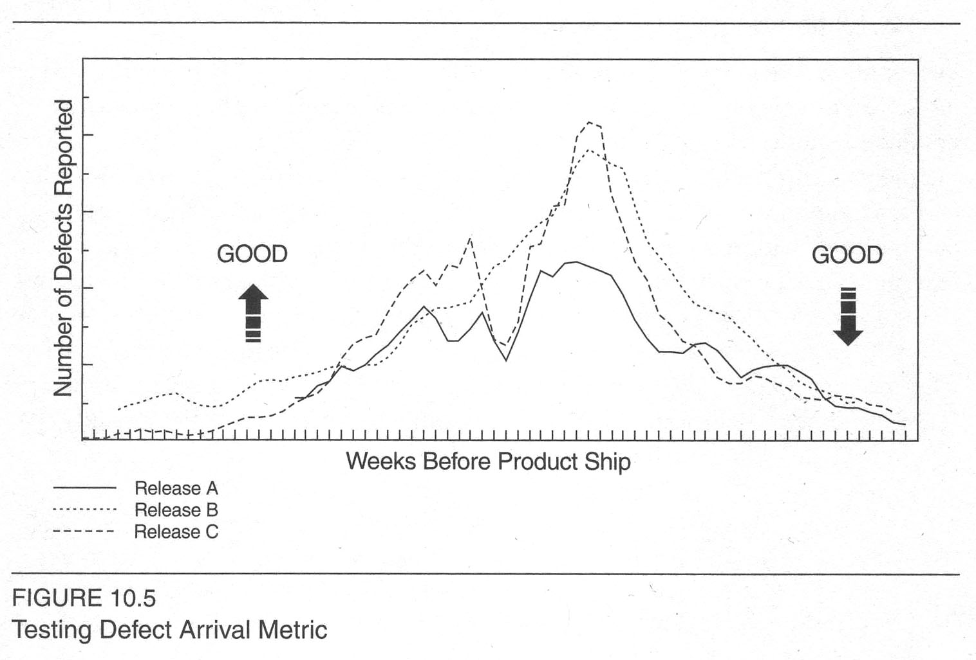
What’s good & bad?
Notes:
Kan p 280

Slide 9
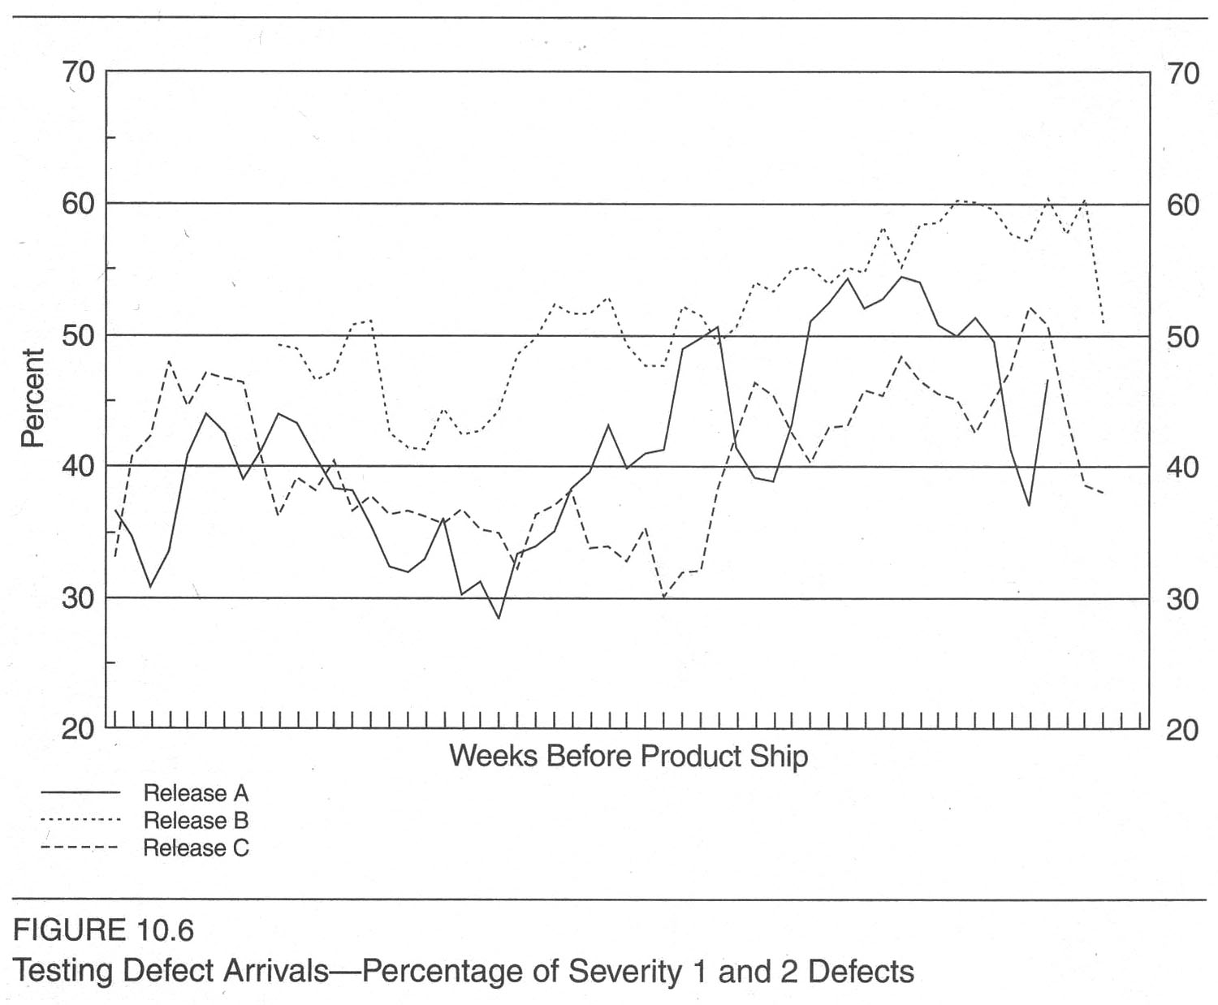
Unfortunate severity pattern…
More high severity at the end!
Notes:
Kan p 281

Slide 10
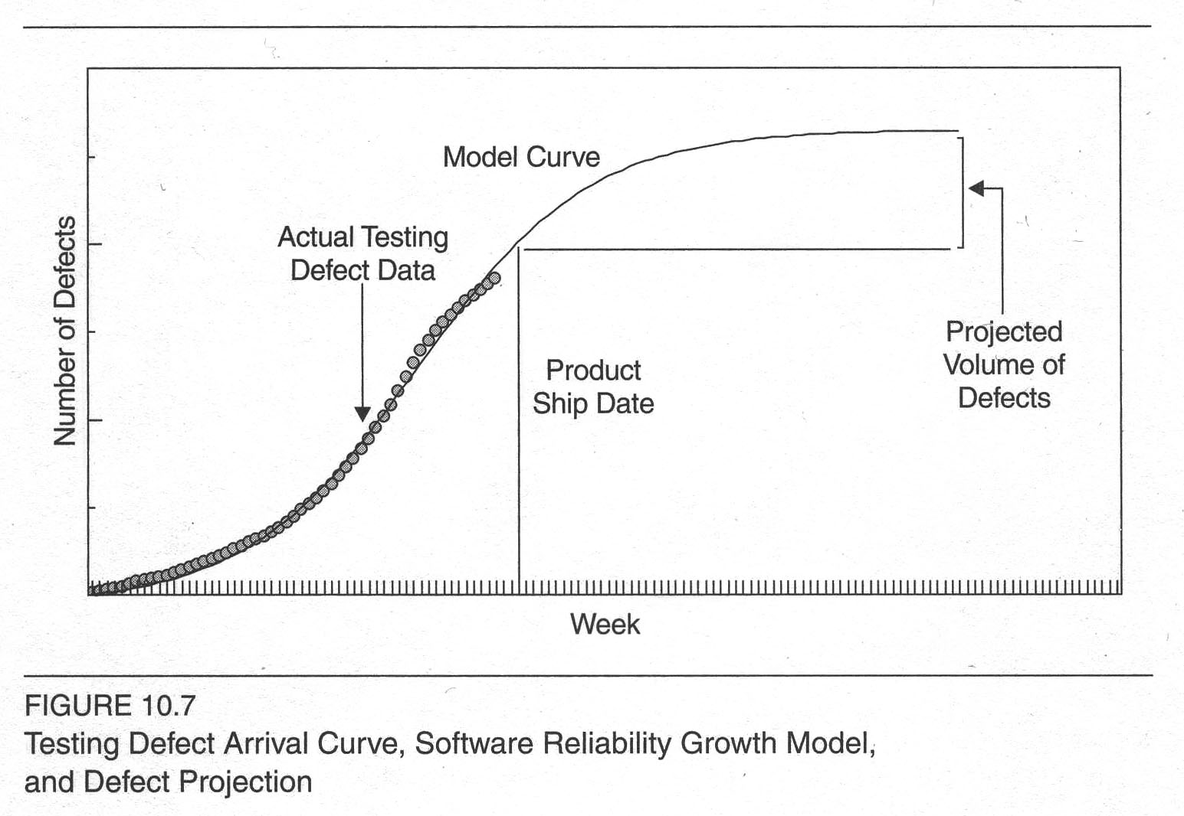
Putting it all together
Notes:
Kan p 282

Slide 11
Defect backlog testing
Testing the “defects remaining.”
Use PTR backlog to judge.
  Shows test progress.
  Notes “customer rediscoveries.”
A large number of defects during development impedes test progress.
If you have a different organization for development testing vs fixing defects in the field, don’t ship with a significant backlog!
Why?
Notes:
Kan p 283

Slide 12
When to focus on the backlog
During prime time for development testing,
  The focus should be on test effectiveness and test execution.
  Focusing too early on overall backlog conflicts with this.
    Development team is reluctant to report defects!
    Focus should be on fix turnaround of defects that impede test progress, vs on the entire backlog.
When testing approaches completion,
  Then do strong focus on overall defect backlog.

Slide 13
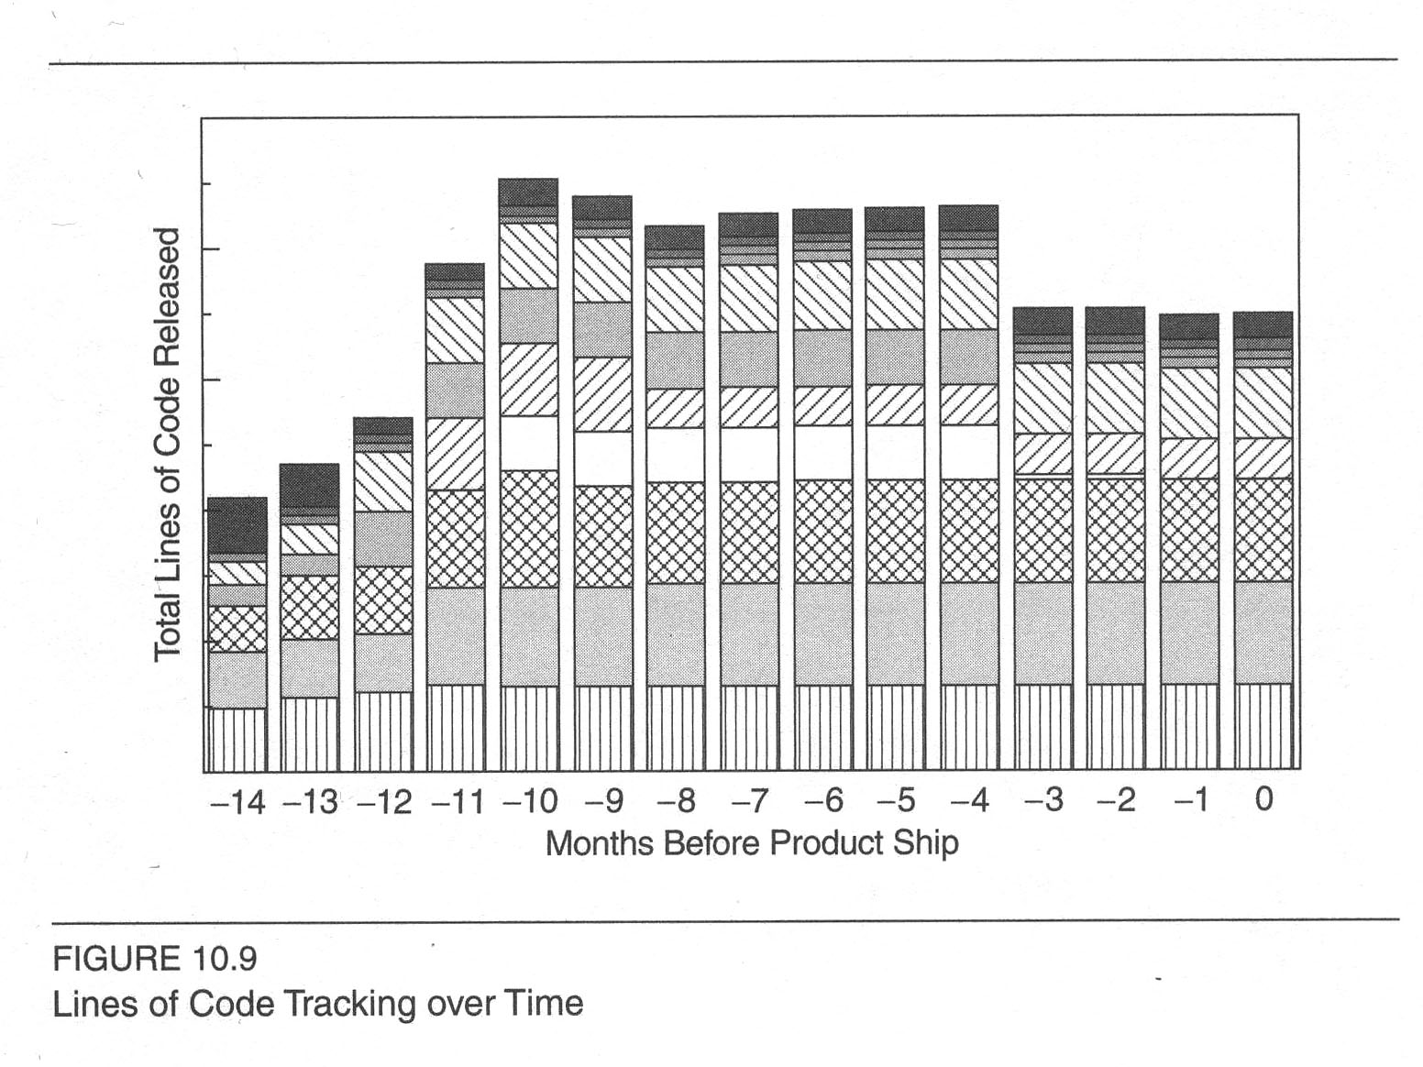
Product size as an indicator
Lines of code = “Effort”?
Explains test progress
Helps measure total
defect volume per
unit.
Feature removed – very interesting!
Notes:
Kan p 285

Slide 14
CPU Utilization?
There actually are many types of measurements you might want to do during a “stress test.”
CPU usage is certainly one of these.
  Kan’s discussion is important – issues like “where the peaks occur, during a customer’s duty cycle” need to be investigated.
We’ll talk about this all later, under “performance metrics” (week 7)

Slide 15

System Crashes
Alias reboots, or IPLs (Initial Program Loads)
Alias “hangs”
  This can also be starvation or deadlock, etc.
Related to CPU utilization
  That leads to breaking things that
  can’t get done in their usual time
  (e.g., a lock release)
  Also timing errors (more going on)
  Associated resource problems
  (disks, memory)
  High stress level
Notes:
Image from http://installornot.com/editorial/counterthat/

Slide 16
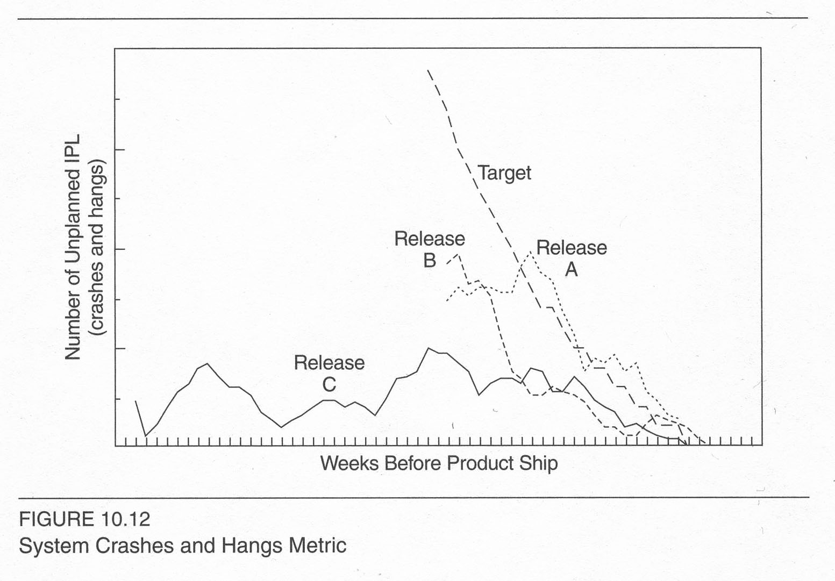
Release by crash count?

Slide 17
Other showstoppers
Takes only a few to render a product dysfunctional.
Qualitative “metric”:
  Number of critical problems over time, with a release-to-release comparison.
  Types of critical problems, and the analysis and resolution of each.

Slide 18
Kan’s recommendations
Use calendar time, instead of phases of the development process, as measurement unit for in-process metrics.
For time-based metrics, use ship date as the reference and weeks as the unit of measurement.
Metrics show “good” or “bad” in terms of quality or schedule.
Know which metrics are subject to strong management intervention.
Metrics should drive improvements.
Notes:
Kan p 294

Slide 19
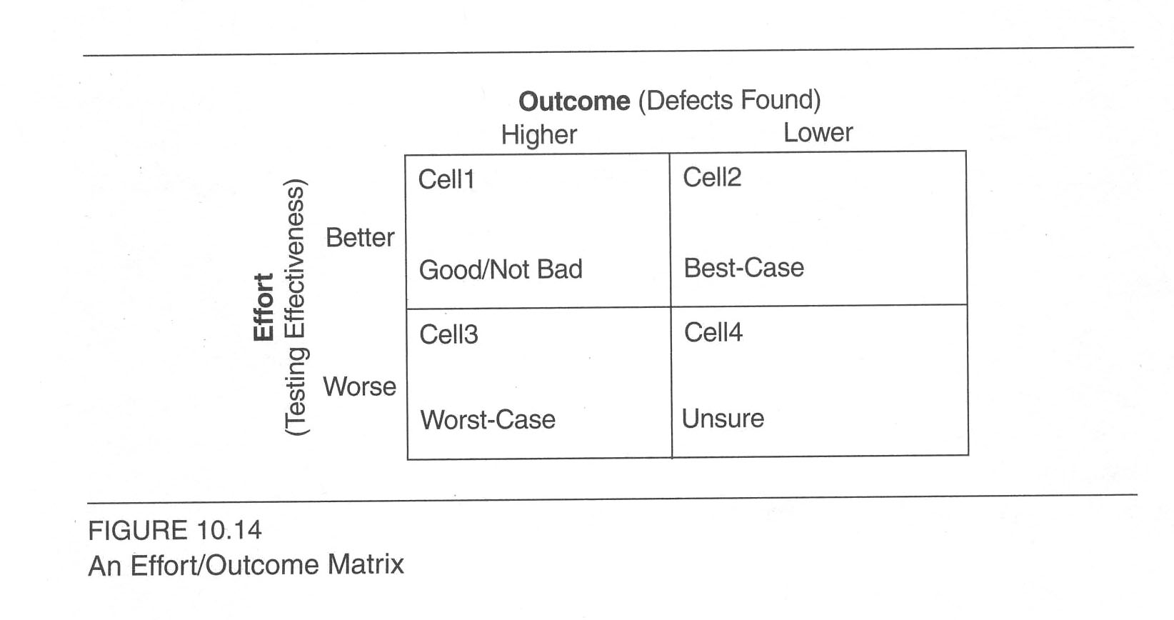
Recommended: Use the effort / outcome model
Notes:
Kan p 299

Slide 20

Test coverage
Setup
Install
Min/max configuration
Concurrence
Error recovery
Cross-product interoperability
Cross-release compatibility
Usability
Double-byte character set (DBCS)
Tends not to be tested enough!
Leads to cascading problems!
Notes:
DBCS – See http://en.wikipedia.org/wiki/DBCS.
Image from http://commons.wikimedia.org/wiki/File:Car_crash_1.jpg.

Slide 21
Metrics for acceptance testing
Related to test cases
  Percentage of test cases attempted
  Number of defects per executed test case
  Number of failing test cases without defect records
Related to test execution records
  Success rate
  Persistent failure rate
  Defect injection rate
  Code completeness
Of course, sometimes “acceptance” means “by the customer”…
Notes:
Kan p 303

Slide 22
Good enough to ship?
System stability, reliability, and availability
Defect volume
Outstanding critical problems
Feedback from early customer programs
Other quality attributes of specific importance to a particular product and its acceptance

Slide 23
Recommendations for small organizations
Use:
  Test progress S curve
  Defect arrival density
  Critical problems or showstoppers
  Effort / outcome model to interpret metrics and manage quality
  Conduct an evaluation on whether the product is good enough to ship

